Slide 1
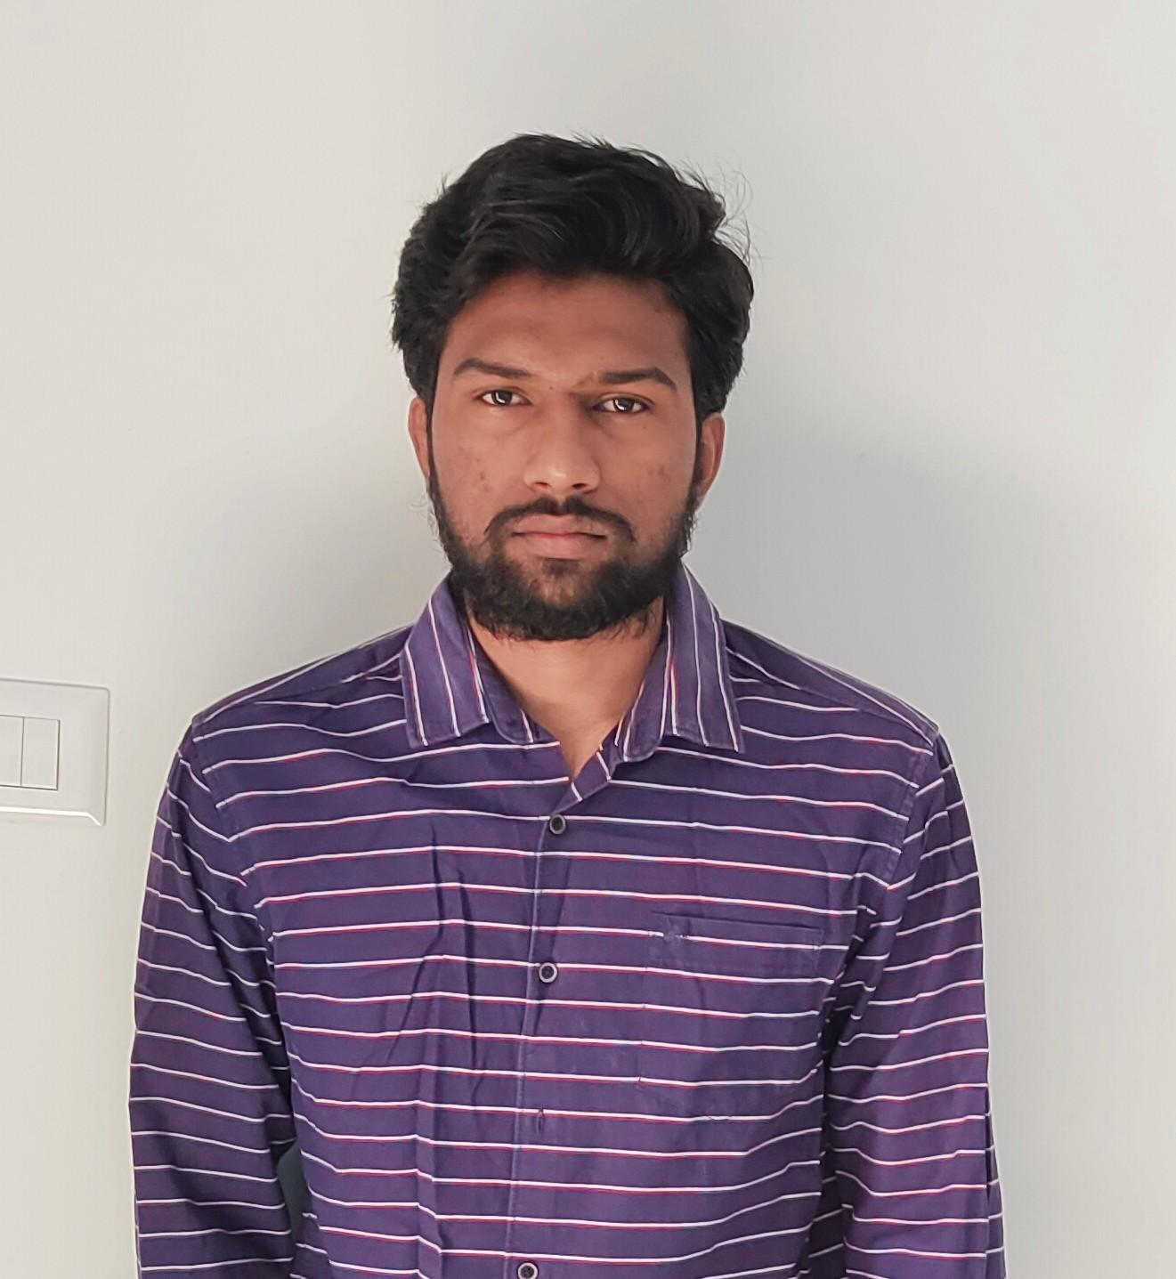
Revuri Tharun
Bachelor Of Technology
Information Technology
YEAR:2017-2021
Analyst/Software Engineer
Skills
Mumbai
JAVA | Basics of java, Core Java,, Oops concepts
UI Framework-Angular | Fundamentals components , Type Script, Routing , Working with HTTP in Angular.
Angular | Components, Services, Modules, Routing, Forms & Validation
Database | MongoDB basics
UI Tech | HTML 5 & CSS 3,JavaScript, Optimized UI Designed
Tools | Spring Tool ,Visual Studio 2019, Visual Studio code, Swagger, Postman
Add On skills | Communications, Team management. Peer learning
Tharun.revuri@capgemini.com
+91 7995266764
A4
Hands on experience in creating Web Application with Spring Boot and Angular.
Proficient in JAVA and OOPs concepts.
Hands on experience in developing web pages using HTML5, CSS3, Object Oriented Programming, python.
Practical understanding of rendering REST API.
Proficient Angular developer with working knowledge on Angular.
Implemented Web API and Angular in case study and up skilling this knowledge continuously.
AGRICULTURE CROP SYSTEM
Working on end to end case study Online Agriculture crop System Application along with Eureka, Swagger and Angular used for user interface.
Java Full Stack Developer in Degreed Platform
Completed this course with optimal Knowledge of MVC ,Web API , RESTful services , Components.

